Slide 1
SMART SURVEYING DEVICE FOR RESOURCE OPTIMIZATION

Slide 2
PROBLEM DESCRIPTION
Today, a lot of research have been published in order to resolve such problem which is count people using video camera. This is not a simple task, there are some situations difficult to solve even with today's computer speeds (the algorithm has to operate in real-time so it makes limits for the complexity of methods for detection and tracking). Maybe one of the most difficult, is people occlusions. When people entering or exiting of the field of view in group, it is very hard to distinguish all the humans in this group. Thanks to all those research, a lot of companies propose people counting system based on video camera. Their system are very accurate and reliable but are also very expensive. The aim of this entire project is to make a cheap prototype able to count people (obviously, it cannot compete in term of accuracy and performance with the companies' system) and maybe, in a close future, this prototype will become a “truly” people counting system and could be commercialized.

Slide 3
METHODOLOGY
This first step of the people counting algorithm is very important and consists to make a Pixel by Pixel absolute difference8 between two consecutive frames. The result of this operation is a new image that shows all the differences between this 2 frames. The difference image represents a motion detector.
The background estimation algorithm makes a reference image which represent the background part of the scene view. The background image is fundamental to detect moving objects and tracking them, and will be used to separate the background and the foreground. To avoid the maximum effect of the noises Pixel, a median filter is applying between five consecutive frames in order to obtain a good estimate of the model.

Slide 4
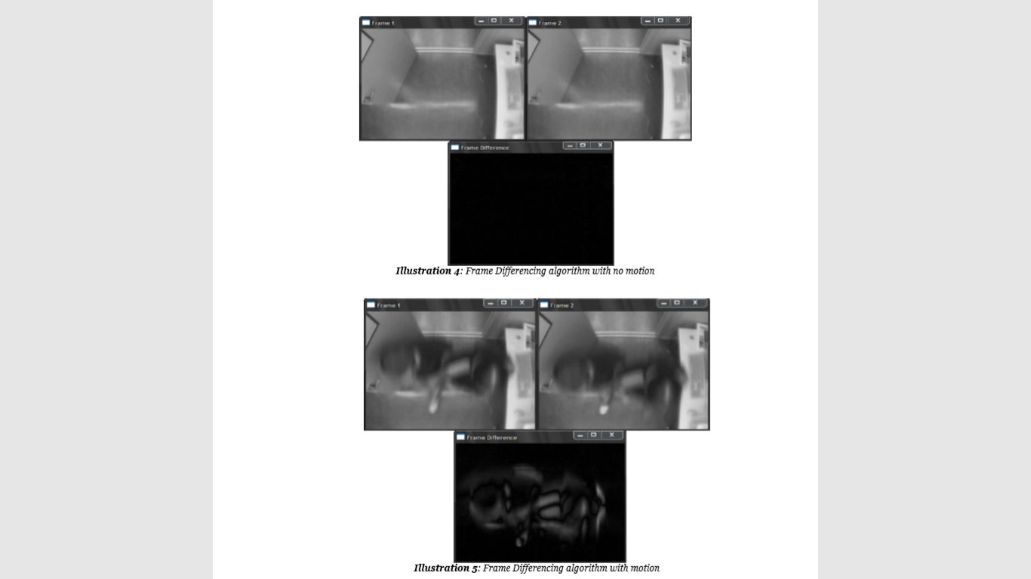

Slide 5
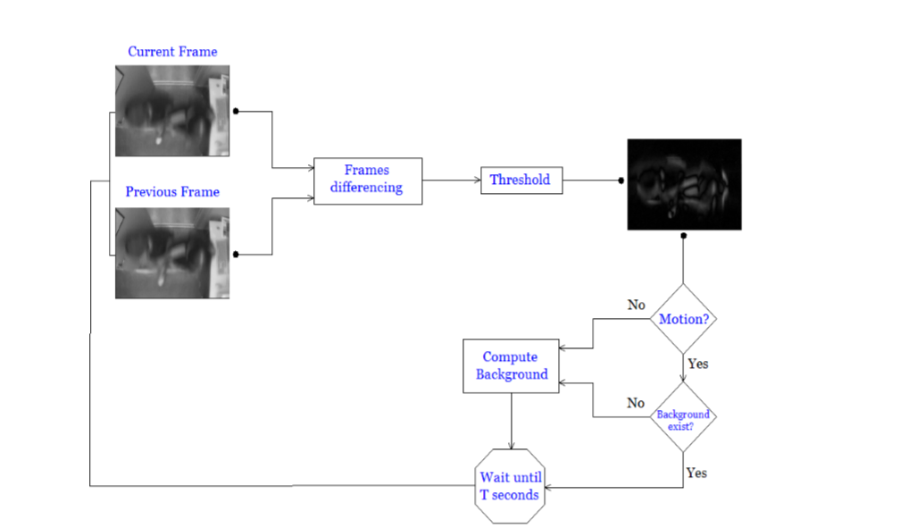
BLOCK DIAGRAM:-

Slide 6
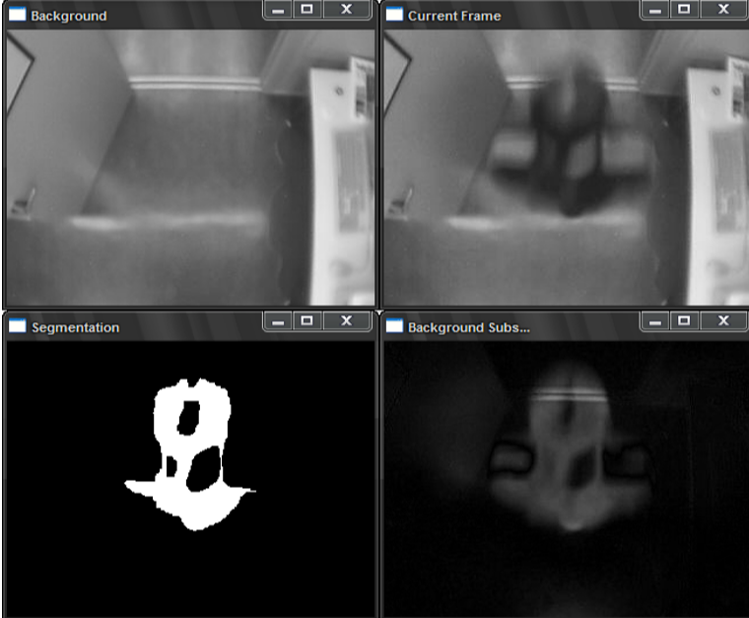

Slide 7
COUNTING PROCESS
The counting process consists to determine the direction of blobs which cross a virtual line in order to increment the good counter. There is two different way to make this process in the case of using an overhead camera. The first one is to use two virtual lines which represent the Entering (IN) and the Exit (OUT). If a blob cross over completely a virtual line, in the good direction, then the algorithm increments the correspondent counter (if the current blob is a merging blob, the algorithm looks how many blobs composed it and increments with the same number). Because the algorithm memorizes the features of each blobs it can easily deduce the direction of the motion (for example, by looking the position of the centroid).

Slide 8
IMPROVEMENTS AND CONCLUSION
Because of the short time limit to develop the people counting system, the prototype is not very advanced and can easily be improved. This section covers all the features which can be added in order to improve the entire people counting algorithm. This section is divided in two parts, the first one describes all the different improvement for a people counting application and the second one gives some ideas to extend the prototype to other applications.
A people tracking system cans be used for others applications not necessarily just for counting people. For example, this systems can be extended for security application. In fact, a real-time people tracking system provides enough information in order to make a good video surveillance. Detect strange behaviours of people (like violent gesture, fight or running people) and store those informations on a database. This type of system cans be very interesting for storekeeper or supermarket. An other application is for marketing. It can analyse the behaviours of clients and make conclusion. For example, measure the impact of an advertisement or modification in the arrangement. Determine the period and place of good and bad influence

Slide 9
THANK YOU
BY
P SUSHANTH REDDY
SHAIK KABEER BASHA
D SAI MANIKANTA

